Slide 1
AUTOMobiLE SYSTEM

Slide 2
ABSTRACT
This application framework combines powerful inventory search features for both new and used car configuration with pricing information, separate photo galleries and side-by-side comparison tools. For supporting dealers, this system connects dealers with private-party sellers to buy new or used cars over the web.
Dealers can get register to the system's web site and can promote their dealership with enhanced listings, featuring photos and interactive links to their website. The registered dealers can receive responses from the site-surfers or sellers instantaneously by the information flowing in the system and can respond accordingly. In order to support sellers, this system facilitates sellers to place ads online for their used vehicle.

Slide 3
HARDWARE SPECFICATION
Processor : P 4 700 GHz.
RAM : 4 GB RAM
Hard Disk Drive : 180 GB

Slide 4
SOFTWARE SPECIFICATION
Operating System : Windows 7/8/10
Front End : JAVA
Back End : SQL

Slide 5
EXISTING SYSTEM
In the existing scenario, if someone has to buy a car or even interested in buying any car, then the person has to go to the showroom. Not only once, but every time, whenever he/she is looking for some fact, the only option left is to go to the showroom. This is very time consuming and very hectic as well. Sometimes, the buyer even lost interest because of this practice.
DISADVANTAGES
Can’t view the exact details in other sites
Some fake site’s are created in some different portal
Cheating are may be happened.

Slide 6
PROPOSED SYSTEM
The proposed automobile system is very effective. If someone is interested in buying any car, then he/she can check all the information related to the car in the given portal. He/she can even book the test drive within the system. The proposed system also helps the buyer to check which cars and companies are good for them, by showing them the past reviews about the car/companies. The proposed system is so helpful and effective.
ADVANTAGES
Can Book a vehicle in a minute.
Collect the all the information about the customer
Very user-friendly to handle this

Slide 7
Modules
1. CAR MODULE
All the facts and figures related to a car of each model is present in this module & the viewer can view this module after login into the system. New car details and existing car details are added into this module. Lists of all the cars are available inside this module.
2. COMPANY MODULE
All the details of the company are added to the module. Along with the existing details, new details are also added into this module about the company and various new companies are being updated by the admin of the system, frequently.

Slide 8
3. BOOKING MODULE
Via this module, the user or customer of this system can book the cars for them. If they are not willing to book the car, then they can at least book a test drive for themselves. All the previous booking details are available through this module. Admin can update the details as per the need.
4. CUSTOMER MODULE
This module is designed specifically for the customers. They can log in into the system after getting their credentials. This module keeps track of each and every customer and all the information related to each customer is being added into this module. This module is updated timely by the admin of this system.

Slide 9

Data Flow Diagram
Level 0

Slide 10
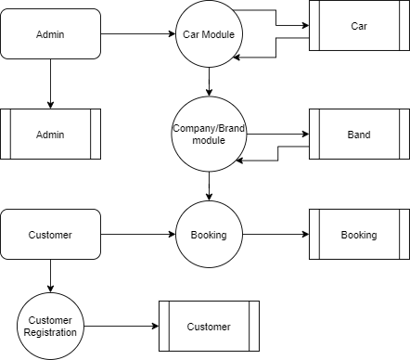
Level 1:

Slide 11
Thank You

